Slide 1
DNR TD Course
Afternoon Session
Behavior, Etiquette & Law

Slide 2
Concepts
  Authorised & Un-Authorised Information
  Logical Alternatives
  Penalty Cards
  Comparable Calls

Slide 3
Background
World Bridge Federation Law Book (2017)
Irish Bridge Union Version
Contract Bridge Association of Ireland (CBAI) Regulations
Local Club Regulations

Slide 4
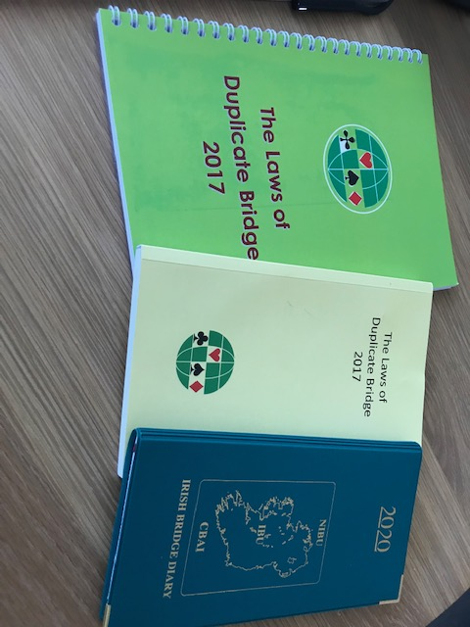
Current Sources

Slide 5
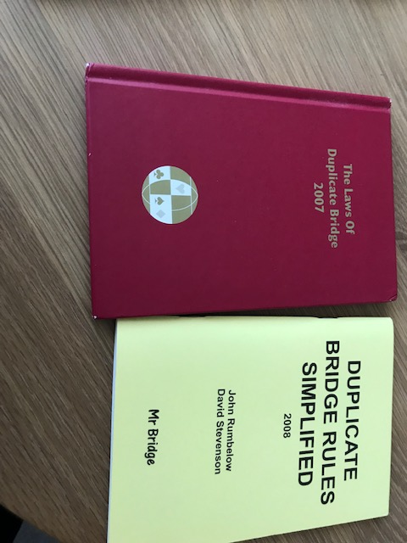
Outdated Sources – Don’t Use!

Slide 6
Arrive At The Table
TD may Assign you a Table (Law 5)
Decide NS and EW by mutual agreement
Shuffle and Deal (6A & 6B). No Goulash dealing.
LAW 74 - CONDUCT AND ETIQUETTE. A - Proper Attitude
  1. A player should maintain a courteous attitude at all times.
  2. A player should carefully avoid any remark or extraneous action that might cause annoyance or embarrassment to another player or might interfere with the enjoyment of the game.

Slide 7
Laws Governing Position of Boards & Auction
Greet Opponents, Describe System (CBAI)
Board in centre of table, correctly orientated (Law 7A)
Count cards, face down (Law 7B2)
Sitting Players are primarily responsible for proper procedure(Law 7D)
If a hand is passed out “there shall be no re-deal” (Law 22B)
Don’t play with bidding boxes. A bid is made when the card is placed on the table (CBAI)
Tempo

Slide 8
Announcements & Alerts
Announce
  Range of 1NT opening (e.g. 12-14) but NOT 2NT
  Transfer to Hearts or Transfer to Spades
  Could be 2 (or whatever) cards on partner opening a prepared minor
Alert Conventional Bids
  Including forcing 1♣ opening
  Weak bids
Don’t Alert
  5 card majors
  Stayman (Vanilla)
  Acol 2♣ opening (Classic)

Slide 9
Above 3NT
Don’t alert above 3NT – Why?
If alertable bids were made:
  At end of auction, declarers alerts after last pass BEFORE lead is selected
  Defenders alert after lead is selected but BEFORE it is faced. Leader asks partner’s permission to face the lead card
This does not apply where self-alerting is in use
  BBO
  Major Tournaments where Screens are in use

Slide 10
How to Alert
Wave the Alert Card in such a way as to ensure that both your opponents see it; then replace it in bidding box.
Don’t speak unless you’re spoken to!!!
Who can ask?
  The opponent whose turn it is to bid
How should they ask?
  “Please Explain”
How do you explain?
  Succinctly. Use convention name if opponents would reasonably be expected to know it, otherwise explain in more detail

Slide 11
Alerts of Doubles
During the first two rounds of bidding, all doubles of natural suit bids at the 1 or 2 level are assumed to be for take-out. Note that Negative Doubles are deemed a type of takeout double as are Re-Opening Doubles. All other doubles are assumed to be for penalty. Any variations from this must be alerted.
So, if a double of 1NT is not penalty orientated, alert it.
Alert the less usual doubles, e.g. Support Doubles

Slide 12
Partnership Agreements & Psychic Bids
Explicit Partnership Agreements are fine (but see HUMs & Brown Sticker Conventions) but must be revealed
Implicit Partnership Agreement are illegal
Psychic Bids are perfectly legal but partner must be as amazed by them as everyone else. If partners Psych with any regularity, this may form the basis of an Implicit Partnership Agreement and lead to fielding of psychs – the greatest offence after downright cheating

Slide 13
HUMs & Brown Sticker Conventions
Example of HUMs
  Pass shows a hand with 12+ points
  1 level opening bids are weaker than pass
  Any 1 level opening bid a King or more less than an average (10) hand
Example of Brown sticker Convention
  Any Opening Bid from 2C through to 3S which could be weak but has no identified 4+ card suit (aka Anchor Suit)
  With the Exception of the Multi-Coloured 2D Opening (The Multi)

Slide 14
Normal Systemic Deviations v Psychs
The Don Oakie Opinion
“A bid in which the strength of the hand is within a queen of the agreed or announced strength, and the bid is of a suit of ample length or of Notrump; the length of a suit varies by no more than one card from the agreed or announced length.”

Slide 15
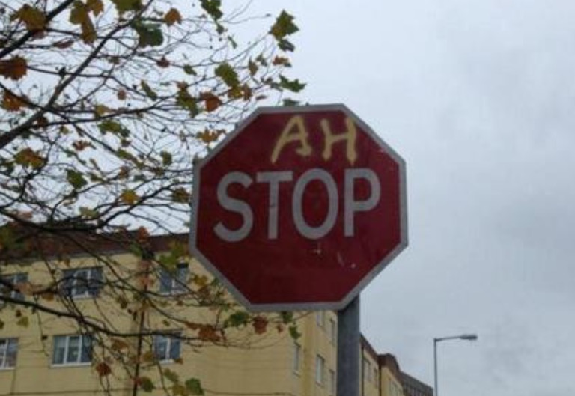

Slide 16
The Stop Card
Used before ANY (and all) skip bids
Purpose is to impose a pause in Tempo
Put it on the table and immediately make your bid
Count to 10 in your head and lift the stop card from the table
It’s nothing to do with the alert card, partner must still alert if the jump bid was conventional
Widely mis-used e.g. never lifted from table
It’s not used to wake up partner (even if it often has that effect!)

Slide 17
Authorised Information
Your Own Cards
Dummy’s Cards
Your Opponents’ Bids
Your Partner’s Bids
Legal Signals & Discards
Carding
Your Opponents’ Demeanour
Your Opponents’ Actions

Slide 18
Unauthorised Information (UI) Law 16
Partner’s Demeanour
Extraneous – Overheard Post-Mortems
Information arising from Mis-Boarding
Partner’s Hesitation
Partner’s Call Out of Turn
Partner’s Insufficient Call
Partner’s Improperly Exposed Card
Psychs (fielding of)
Cheating

Slide 19
Consequences of Acquisition of UI
TD will endeavour to RECTIFY the situation
Adjust the Actual Score
Assignment of Artificial Score
Impose Procedural or Disciplinary Penalty (min 1.5% of total MPs)
There may be Lead Restrictions

Slide 20
Hesitation & Logical Alternatives
You Open a Weak (12-14) 1NT
LHO Overcalls 2♥
Partner wriggles and squirms and after a clear hesitation, bids 2NT
You have 13 HCPs, a 5-card club suit, two Ts and Qx in hearts
What’s going on?
If partner had bid 2NT in Tempo, you would bid 3NT wouldn’t you?
Why did partner hesitate? Maybe he is worried about his heart stopper. Maybe he is a minimum (11). Something is bothering him
So you Pass. They call the TD

Slide 21
Logical Alternative
If UI is possible (e.g. after a hesitation), you can’t make a call or play that is demonstrably suggested over another call or play by the UI, if the other call or play is a logical alternative.
A Logical Alternative is a call or play which a significant proportion of players of like grade would consider and might select.
The platitude that if partner hesitates, you must pass is quite wrong. It is frequently the case but not always.
Logical Alternative Cases lead to Judgements as Opposed to Book Rulings

Slide 22
Penalty Cards
Any Card Exposed During the Auction
Any Card Exposed or Potentially Exposed by Defenders
  The test is: Could offender’s Partner possibly have seem it.
May be Exposed Accidentally
May be Exposed Because it was played Illegally e.g. an Unestablished Revoke
May be Exposed because it was Lead by a player who is not on lead

Slide 23
Minor Penalty Cards Law 50 b & c
A card exposed accidentally during auction or play below the rank of an honour
A T or higher can’t be a minor penalty card
You can’t have more than one minor penalty cards
Disposition
  Play at first legal opportunity but only mandatory if you have no honour
Lead Restrictions on Partner?
  No
UI? Maybe

Slide 24
Major Penalty Cards – Law 50
Any honour card
Any card purposely exposed
Only Defenders can have Penalty Cards
Must be played at the first legal opportunity
If penalty card holder’s partner gets on lead, declarer may
  Forbid the lead of that suit (penalty card picked up) while he retains the lead
  Require the lead of the suit (penalty card picked up)
  Tell him to do as he wants (penalty card remains on the table)
Info from penalty card on table is authorised to the offending pair but if replaced, becomes unauthorised

Slide 25
Things That Go Wrong During Auctions
Pass out of Turn
Bid out of Turn
Unintended Bid
Insufficient Bid
Misinformation

Slide 26
Pass out of Rotation
May be Accepted – Consciously or Inadvertently!
If not accepted, and it was offender’s RHOs turn to call, RHO calls and offender must pass again.
If it was offender’s LHOs turn to call, he does so. Now offender’s partner may make any legal call. When offender is next due to call, he may
  Make a comparable call, in which case all is forgiven.
  If he makes any other call, partner is silenced for 1 round and there may be lead restrictions
If it was offender’s partner’s turn to call, he may make any legal call. When offender is next due to call, he may
  Make a comparable call, in which case all is forgiven.
  If he makes any other call, partner is silenced for 1 round and there may be lead restrictions

Slide 27
Comparable Calls – Law 23
A call is comparable to the call it is replacing if it has;
  The same or similar meaning as that attributable to the withdrawn call OR
  Defines a subset of the possible meanings attributable to the withdrawn call OR
  Has the same purpose (e.g. an asking bid or relay bid) as that attributable to the withdrawn call.
In making a judgement, the TD may need to enquire the meaning of the calls in question in the offending pairs system.
Where an illegal call is replaced by a comparable call, there is no further rectification (BUT see Law 23 C)

Slide 28
Revisiting the Pass out of Rotation
What does pass mean (in normal systems)
  Lack of opening values, says nothing about suits held.
  Any call with that meaning or a subset of that meaning is a Comparable Call
Say partner of offender opens 1♥
  Offender can obviously pass
  Can offender can make a constructive raise i.e. 2♥?
  What about a pre-emptive raise e.g. 4♥?
  A limit raise i.e. 3♥?
  Can offender bid a natural 1NT or 2NT or a new suit?
  Offender cannot make a game forcing raise e.g. Jacoby 2NT or Splinter

Slide 29
Bid out of Rotation – Law 31
You make an Opening Bid out of Rotation
If your LHO or LHO’s Partner was dealer, LHO may accept. If not bidding reverts to the proper dealer and partner may make any legal bid.
At your next turn, you may make a comparable call
If your RHO was dealer, your LHO may accept. If not, call reverts to RHO.
If RHO passes, you must repeat your bid out of turn.
If RHO bids, you must find a comparable call or partner is silenced for 1 round
As usual; lead restrictions, UI and possibility of adjusted score are on.

Slide 30
Insufficient Bid – Law 27
Insufficient Bidders LHO may accept the bid (purposely or not)
If bid not accepted, the insufficient bidder may make the lowest sufficient bid or make a comparable call. In either case, all is forgiven
If insufficient bidder can’t or won’t do either of the above, he may make any other call (including pass). In such cases, partner is silenced for the rest of the auction. There may be lead restrictions.
Another platitude – “If you make an insufficient bid, you must make it good”. NOT TRUE. It’s often the best thing to do but you have options.
27D allows rectification if the infracting pair benefited.

Slide 31
Unintended Calls & Misinformation
Unintended calls (due to mechanical error) may be fixed up to the point that your partner makes a call (Law 24A 1) regardless of how you discovered the error (Law 24 A 3)
If you realise you have given an erroneous explanation of one of your partner’s bids, call the director before end of Clarification Period
If partner misinformed, call director after final pass if declarer or dummy; at end of game if defender.

Slide 32
When is a Card Played?
Make Opening Lead Face Down.
A Defender is deemed to have played a card to the current trick if he holds the card in a way such that his partner could conceivably have seen its face.
Declarer has played a card when he turns it face up, touching or nearly touching the table.
A card is played from Dummy when declarer purposely touches it except for arranging or reaching an adjacent card.
To avoid disputes, consider calling for cards from Dummy.

Slide 33
Opening Lead out of Rotation
East Declarer, North leads out of rotation
E has 5 options which must be chosen without consulting partner.
E may Accept the lead & put his hand down as dummy. W plays it.
E may accept the lead but opt to play it himself. W puts down his dummy. Having seen dummy, E plays and then S plays third to the trick followed by dummy.
E may reject the lead which now becomes a major penalty card. The lead reverts to S. E may now require the lead of suit of the penalty card, forbid it or tell S to do as he pleases.

Slide 34
The Revoke – Laws 61-64
Established when offending side plays to the next trick
If the revoke card won the trick, one transferred
If the offending partnership win a subsequent trick, one transferred
A revoke of the 12th trick must be corrected
The director may award an adjusted score

Slide 35
Two Cards Played – Law 67
If spotted
  If only one is visible then that card is deemed played and the other is replaced without rectification
  If both are visible, offender nominates which card to play and the other becomes a major penalty card if he is a defender
If not spotted until both sides have played to the next trick or later, the director “rewinds” the play, rectifying any problems which arise e.g. revokes

Slide 36
Claims & Concessions – Law 68
If a claim/concession is disputed and everyone agrees to play the hand out, the hand is played out and the director is not called
If there is failure to reach such an agreement, the director is called and be assigns an adjusted score. The hand is not played out.
The latter course is often to the advantage of the disputing side as the dispute may have drawn Declarer’s attention to a flaw in his proposed line of play which he may now be able to fix.

Slide 37
Wrong Board Played – Law 15
Provided neither partnerships have seen the board before, it is played out and the score stands
The director may require both pairs to subsequently play the correct board.
This law change can cause problems for computer scoring systems.

Slide 38
Inspection of Tricks – Law 66
It is now lawful for either players in a partnership to inspect a quitted trick, provided neither have played to the subsequent trick.
In doing so, they must NOT expose the quitted trick.

Slide 39
Mistaken Explanation – Law 75
It is now an infraction to state that a partnership agreement may exist when it doesn’t
If you are asked to explain partner’s call and you can’t, just say so. You are allowed to be confused about your system. That’s not unlawful unless UI or mis-information arises out of it.
You are NOT allowed speculate e.g. don’t say something like “I’m taking that to be a forcing bid”

Slide 40
♠♣♥♦

